Slide 1
ANALYSIS OF SORTING AND SEARCHING ALGORITHMS
LECTURE THREE

Slide 2
BRUTE FORCE
A brute force algorithm is a simple, comprehensive search strategy that systematically explores every option until a problem's answer is discovered.
It's a generic approach to problem-solving that's employed when the issue is small enough to make an in-depth investigation possible.
However, because of their high temporal complexity, brute force techniques are inefficient for large-scale issues.

Slide 3
FEATURES OF THE BRUTE FORCE ALGORITHM
It is an intuitive, direct, and straightforward technique of problem-solving in which all the possible ways or all the possible solutions to a given problem are enumerated.
Many problems are solved in day-to-day life using the brute force strategy, for example, exploring all the paths to a nearby market to find the minimum shortest path.
Arranging the books in a rack using all the possibilities to optimize the rack spaces, etc.
Daily life activities use a brute force nature, even though optimal algorithms are also possible.

Slide 4
PROS AND CONS OF BRUTE FORCE ALGORITHM
Pros:
The brute force approach is a guaranteed way to find the correct solution by listing all the possible candidate solutions for the problem.
It is a generic method and not limited to any specific domain of problems.
The brute force method is ideal for solving small and simpler problems.
It is known for its simplicity and can serve as a comparison benchmark

Slide 5
PROS AND CONS OF BRUTE FORCE ALGORITHM
Cons:
The brute force approach is inefficient. For real-time problems, algorithm analysis often goes above the O(N!) order of growth.
This method relies more on compromising the power of a computer system for solving a problem than on a good algorithm design.
Brute force algorithms are slow.
Brute force algorithms are not constructive or creative compared to algorithms that are constructed using some other design paradigms.

Slide 6
SORTING ALGORITHMS
Sorting refers to arranging data in a particular format.
Sorting algorithm specifies the way to arrange data in a particular order. Most common orders are in numerical or lexicographical order.
The importance of sorting lies in the fact that data searching can be optimized to a very high level, if data is stored in a sorted manner. Sorting is also used to represent data in more readable formats.

Slide 7
TYPES OF SORTING ALGORITHMS
Sorting algorithms can be broadly classified into two categories:
  Comparison-based and
  Non-comparison-based algorithms

Slide 8
TYPES OF SORTING ALGORITHMS
Comparison-based algorithms compare elements in the input to determine their order, and thus their time complexity is lower bounded by the number of comparisons needed to correctly order the input.
All the sorting algorithms mentioned in this blog post, including Bubble Sort, Selection Sort, Insertion Sort, Merge Sort, Quick Sort, and Heap Sort, are comparison-based algorithms.

Slide 9
TYPES OF SORTING ALGORITHMS
Non-comparison-based algorithms, on the other hand, do not rely on element comparisons to determine their order.
These algorithms are often more specialized and are used in specific situations where the input has certain properties.
For example, counting sort is a non-comparison-based algorithm that can be used to sort inputs consisting of integers with a small range.

Slide 10
TYPES OF SORTING ALGORITHMS
Another way to classify sorting algorithms is based on their stability.
A sorting algorithm is said to be stable if it preserves the relative order of equal elements in the input.
Merge Sort and Insertion Sort are stable algorithms, while Quick Sort and Heap Sort are unstable algorithms.

Slide 11
SORTING TECHNIQUES
Bubble Sort
Selection Sort
Insertion Sort
Merge Sort
Quick Sort
Heap Sort

Slide 12
BUBBLE SORT
Bubble sort is a simple sorting algorithm.
This sorting algorithm is comparison-based algorithm in which each pair of adjacent elements is compared and the elements are swapped if they are not in order.
This algorithm is not suitable for large data sets as its average and worst case complexity are of O(n2) where n is the number of items.

Slide 13
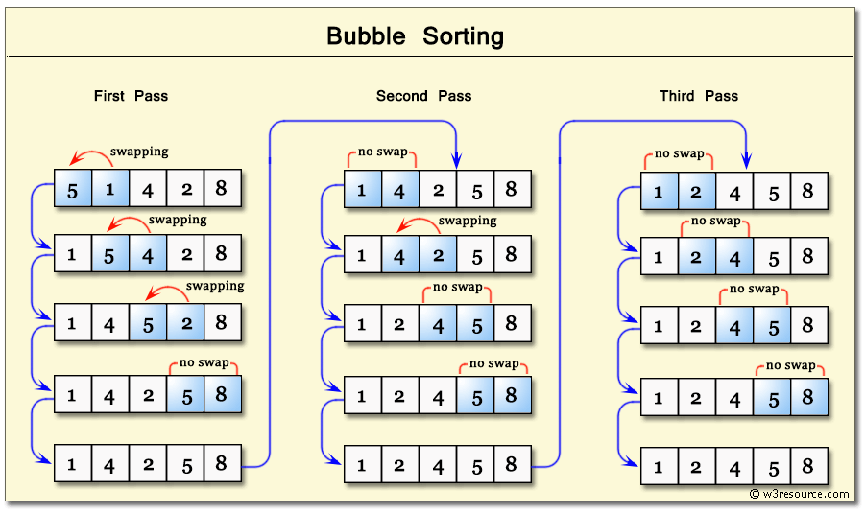

Slide 14
BUBBLE SORT ALGORITHM
Bubble Sort is an elementary sorting algorithm, which works by repeatedly exchanging adjacent elements, if necessary. When no exchanges are required, the file is sorted.
We assume list is an array of n elements. We further assume that swap function swaps the values of the given array elements.
Step 1 − Check if the first element in the input array is greater than the next element in the array.
Step 2 − If it is greater, swap the two elements; otherwise move the pointer forward in the array.

Slide 15
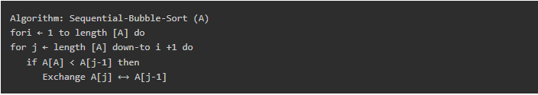
BUBBLE SORT ALGORITHM
Step 3 − Repeat Step 2 until we reach the end of the array.
Step 4 − Check if the elements are sorted; if not, repeat the same process (Step 1 to Step 3) from the last element of the array to the first.
Step 5 − The final output achieved is the sorted array.

Slide 16
BUBBLE SORT ALGORITHM
Pseudocode
We observe in algorithm that Bubble Sort compares each pair of array element unless the whole array is completely sorted in an ascending order. This may cause a few complexity issues like what if the array needs no more swapping as all the elements are already ascending.
To ease-out the issue, we use one flag variable swapped which will help us see if any swap has happened or not. If no swap has occurred, i.e. the array requires no more processing to be sorted, it will come out of the loop.

Slide 17
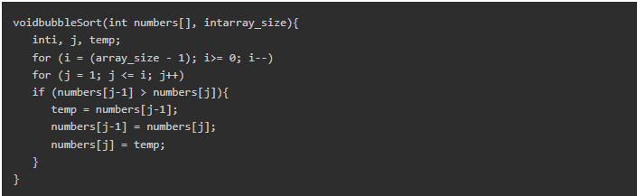
BUBBLE SORT ALGORITHM
Pseudocode of bubble sort algorithm can be written as follows

Slide 18
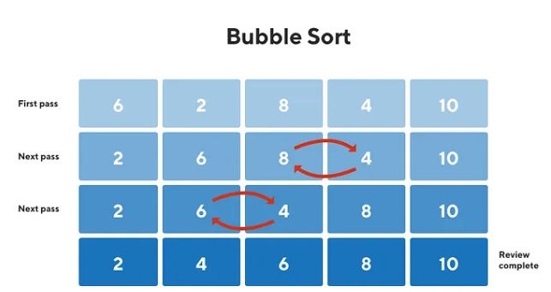
BUBBLE SORT ALGORITHM

Slide 19
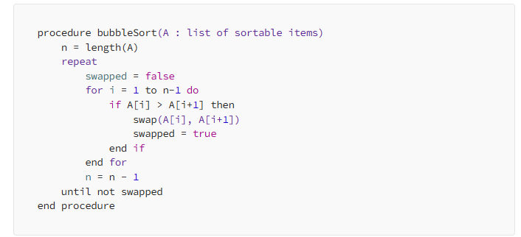
BUBBLE SORT ALGORITHM
here’s, pseudocode for the same.

Slide 20
INSERTION SORT
Insertion sort is a very simple method to sort numbers in an ascending or descending order.
This method follows the incremental method. It can be compared with the technique how cards are sorted at the time of playing a game.
This is an in-place comparison-based sorting algorithm. Here, a sub-list is maintained which is always sorted.
For example, the lower part of an array is maintained to be sorted. An element which is to be 'inserted' in this sorted sub-list, has to find its appropriate place and then it has to be inserted there.

Slide 21
INSERTION SORT
The array is searched sequentially and unsorted items are moved and inserted into the sorted sub-list (in the same array).
This algorithm is not suitable for large data sets as its average and worst case complexity are of (n2), where n is the number of items.
Insertion algorithm: a simple sorting algorithm that builds a sorted list one element at a time by iteratively inserting each element into its correct position within the sorted portion of the list.

Slide 22
INSERTION SORT ALGORITHM
Now we have a bigger picture of how this sorting technique works, so we can derive simple steps by which we can achieve insertion sort.
Step 1 − If it is the first element, it is already sorted. return 1;
Step 2 − Pick next element
Step 3 − Compare with all elements in the sorted sub-list
Step 4 − Shift all the elements in the sorted sub-list that is greater than the value to be sorted
Step 5 − Insert the value
Step 6 − Repeat until list is sorted

Slide 23
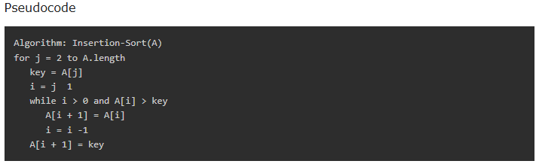
INSERTION SORT ALGORITHM

Slide 24
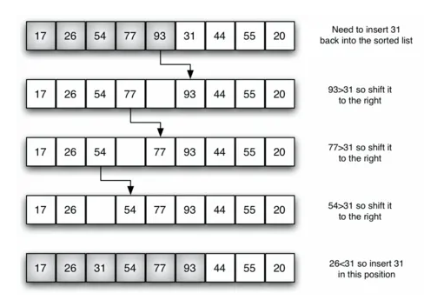
INSERTION SORT ALGORITHM

Slide 25
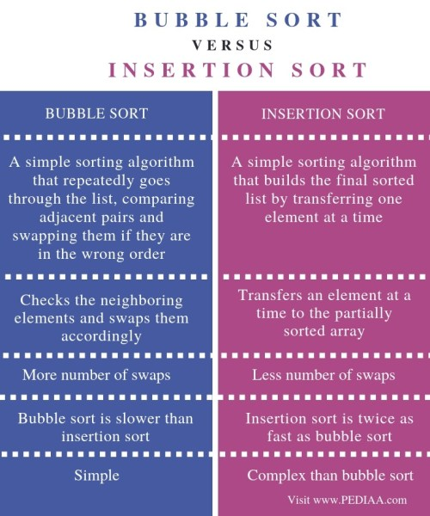

Slide 26
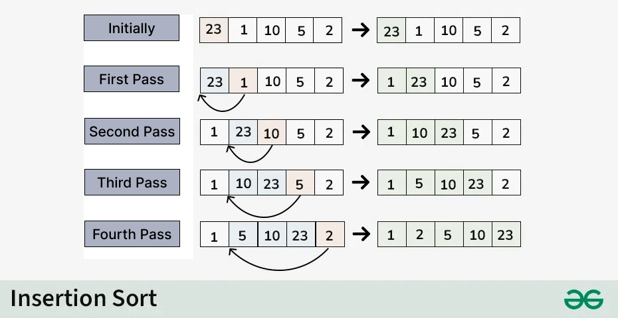

Slide 27
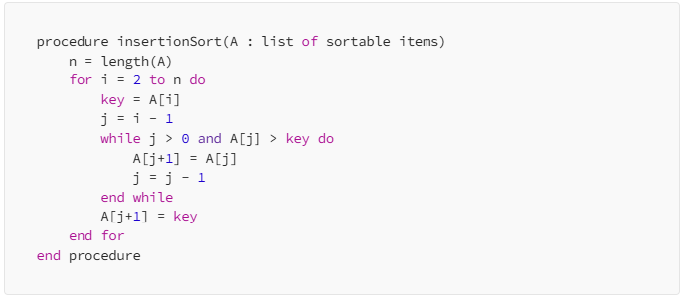
INSERTION SORT ALGORITHM

Slide 28
SELECTION SORT
Selection sort is a simple sorting algorithm.
This sorting algorithm, like insertion sort, is an in-place comparison-based algorithm in which the list is divided into two parts, the sorted part at the left end and the unsorted part at the right end. Initially, the sorted part is empty and the unsorted part is the entire list.
The smallest element is selected from the unsorted array and swapped with the leftmost element, and that element becomes a part of the sorted array. This process continues moving unsorted array boundaries by one element to the right.
This algorithm is not suitable for large data sets as its average and worst case complexities are of O(n2), where n is the number of items.

Slide 29
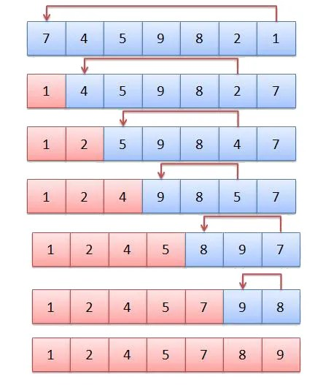

Slide 30
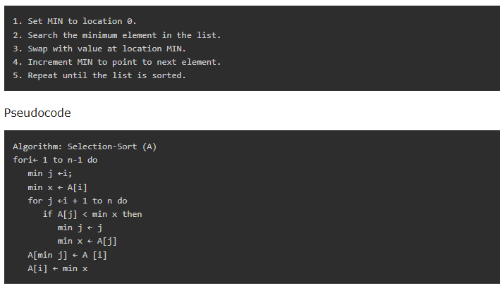
SELECTION SORT ALGORITHM

Slide 31
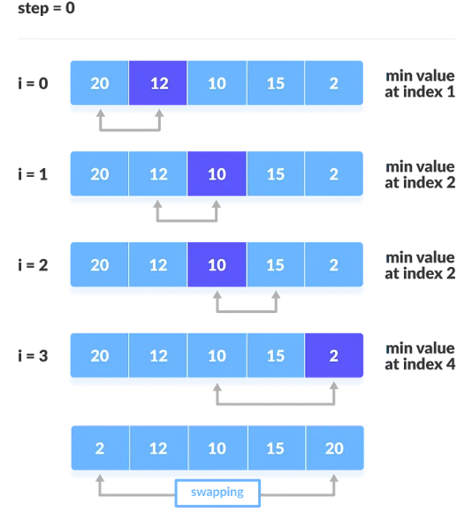
SELECTION SORT ALGORITHM

Slide 32
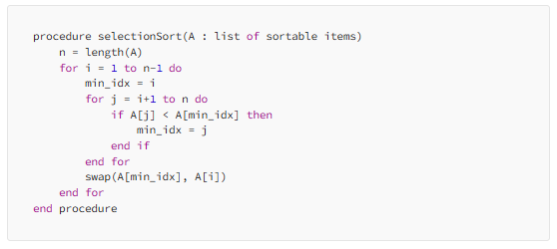
SELECTION SORT ALGORITHM

Slide 33
MERGE SORT ALGORITHM
Merge sort is a divide-and-conquer algorithm that works by dividing the list into smaller sub-lists, sorting them, and then merging them back together.
The algorithm recursively divides the list in half until each sub-list contains only one element. It then merges the sub-lists back together, comparing the elements in each sub-list and merging them in the correct order.
Merge sort has a time complexity of O(n log n) and is more efficient than the previous algorithms for large datasets.

Slide 34
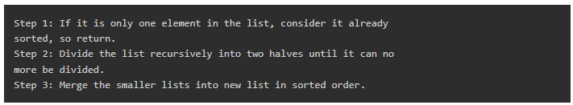
MERGE SORT ALGORITHM

Slide 35
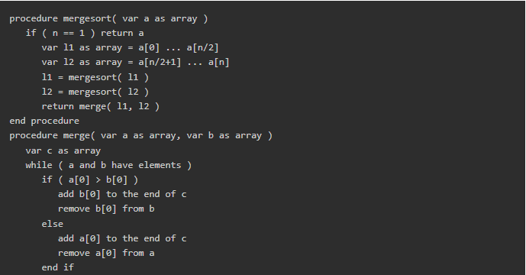
MERGE SORT ALGORITHM
Pseudocode

Slide 36
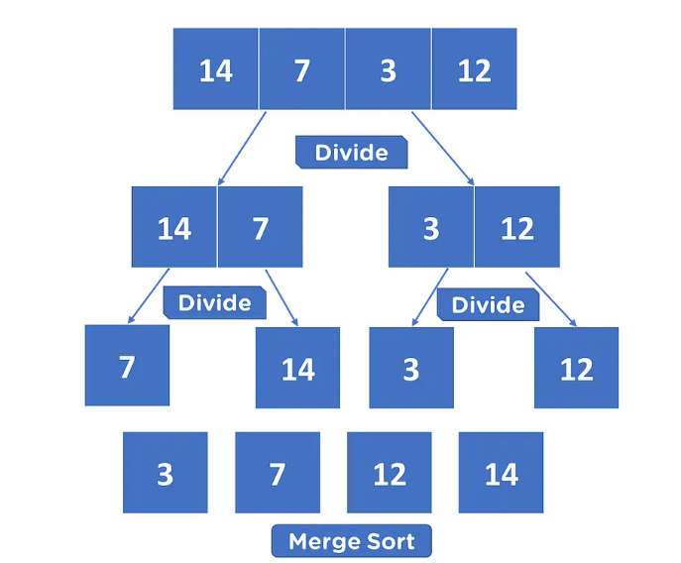
MERGE SORT ALGORITHM

Slide 37
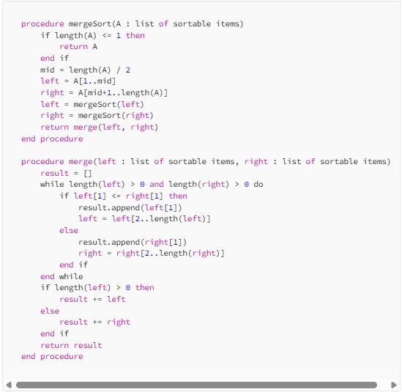
SELECTION SORT ALGORITHM

Slide 38
QUICK SORT
Quick sort is a highly efficient sorting algorithm and is based on partitioning of array of data into smaller arrays.
A large array is partitioned into two arrays one of which holds values smaller than the specified value, say pivot, based on which the partition is made and another array holds values greater than the pivot value.
Quicksort partitions an array and then calls itself recursively twice to sort the two resulting subarrays.
This algorithm is quite efficient for large-sized data sets as its average and worst-case complexity are O(n2), respectively.

Slide 39
QUICK SORT ALGORITHM
Quick sort is another divide-and-conquer algorithm that works by selecting a pivot element from the list and partitioning the other elements into two sub-lists, according to whether they are less than or greater than the pivot element.
The algorithm then recursively sorts the sub-lists, using the same pivot element selection and partitioning process until the entire list is sorted.
Quick sort has a time complexity of O(n log n) and is more efficient than merge sort for small to medium-sized datasets.

Slide 40
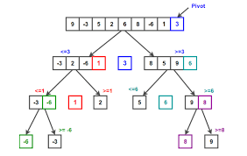

Slide 41
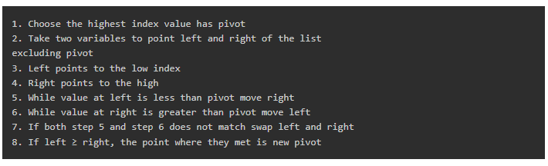
QUICK SORT PIVOT ALGORITHM

Slide 42
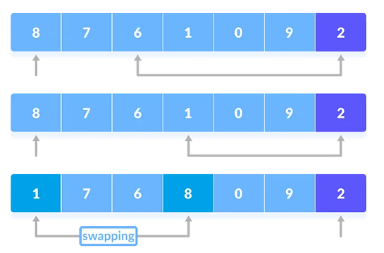
QUICK SORT PIVOT ALGORITHM

Slide 43
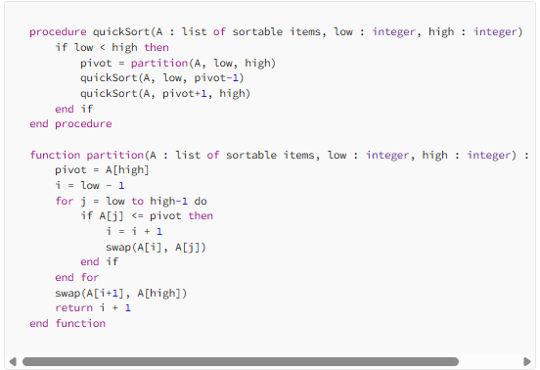
QUICK SORT PIVOT ALGORITHM

Slide 44
HEAP SORT ALGORITHM
Heap Sort is an efficient sorting technique based on the heap data structure.
The heap is a nearly-complete binary tree where the parent node could either be minimum or maximum.
The heap with minimum root node is called min-heap and the root node with maximum root node is called max-heap.
The elements in the input data of the heap sort algorithm are processed using these two methods.

Slide 45
HEAP SORT ALGORITHM
Heap sort has a time complexity of O(n log n) and is more efficient than the previous algorithms for large datasets.

Slide 46
HEAP SORT ALGORITHM
The heap sort algorithm follows two main operations in this procedure
Builds a heap H from the input data using the heapify (explained further into the chapter) method, based on the way of sorting ascending order or descending order.
Deletes the root element of the root element and repeats until all the input elements are processed.

Slide 47
HEAPIFY METHOD
The heapify method of a binary tree is to convert the tree into a heap data structure. This method uses recursion approach to heapify all the nodes of the binary tree.
The binary tree must always be a complete binary tree as it must have two children nodes always.
The complete binary tree will be converted into either a max-heap or a min-heap by applying the heapify method.

Slide 48
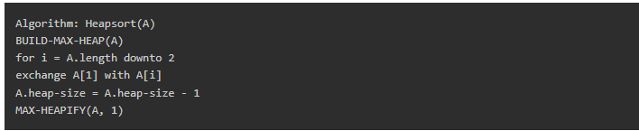
HEAP SORT ALGORITHM
As described in the algorithm below, the sorting algorithm first constructs the heap ADT by calling the Build-Max-Heap algorithm and removes the root element to swap it with the minimum valued node at the leaf. Then the heapify method is applied to rearrange the elements accordingly.

Slide 49
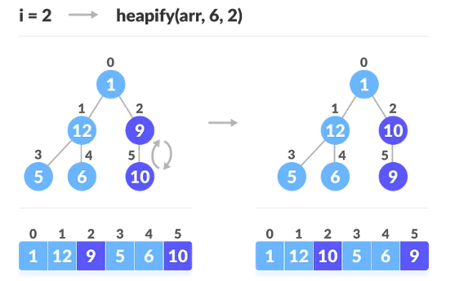
HEAP SORT ALGORITHM

Slide 50
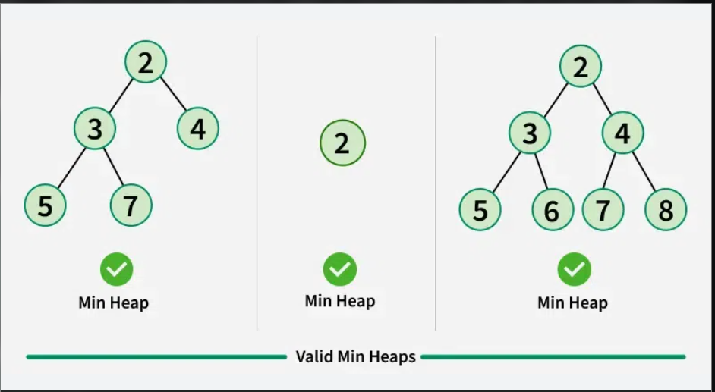

Slide 51
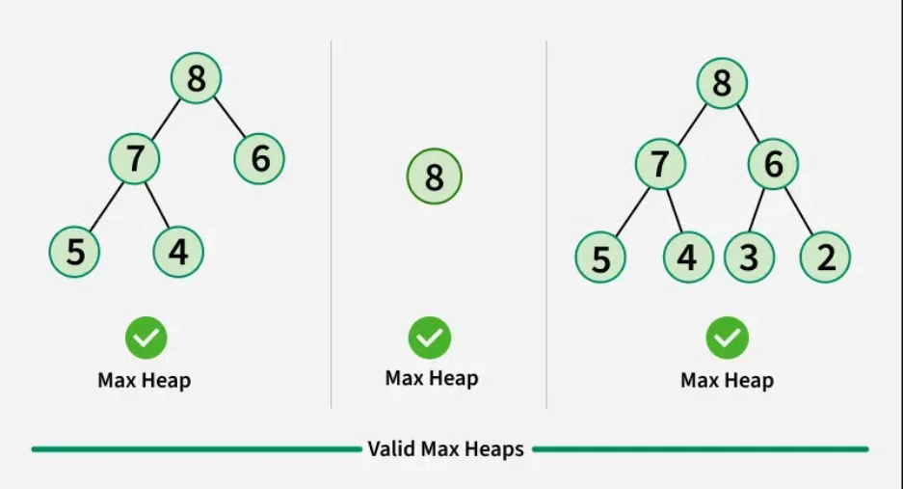

Slide 52
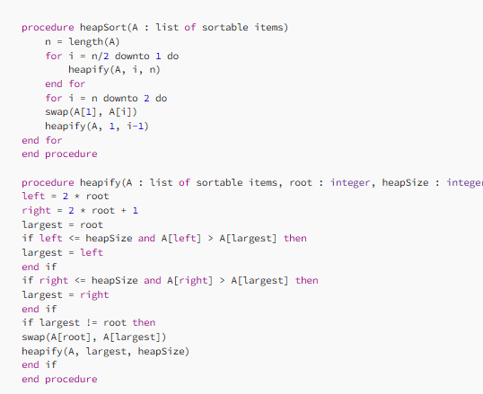
HEAP SORT ALGORITHM

Slide 53
SEARCHING ALGORITHMS
Searching algorithms are essential tools in computer science used to locate specific items within a collection of data. In this tutorial, we are mainly going to focus upon searching in an array.
When we search an item in an array, there are two most common algorithms used based on the type of input array.
  Linear Search
  Binary Search

Slide 54
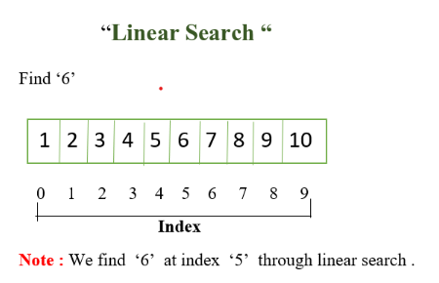
LINEAR SEARCH ALGORITHM
Linear search is defined as the searching algorithm where the list or data set is traversed from one end to find the desired value

Slide 55
LINEAR SEARCH ALGORITHM
It is used for an unsorted array.
It mainly does one by one comparison of the item to be search with array elements. It takes linear or O(n) Time.

Slide 56
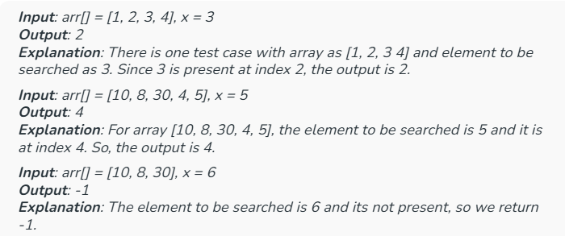
LINEAR SEARCH ALGORITHM
Given an array, arr of n integers, and an integer element x, find whether element x is present in the array.
Return the index of the first occurrence of x in the array, or -1 if it doesn't exist.

Slide 57
LINEAR SEARCH ALGORITHM
In Linear Search, we iterate over all the elements of the array and check if it the current element is equal to the target element.
If we find any element to be equal to the target element, then return the index of the current element. Otherwise, if no element is equal to the target element, then return -1 as the element is not found.
Linear search is also known as sequential search.

Slide 58
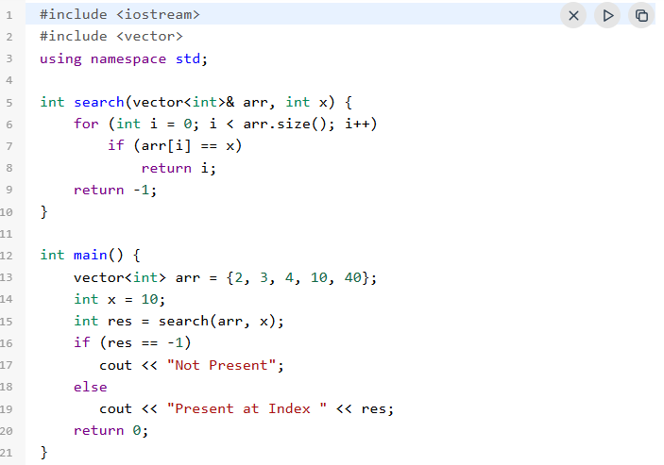
LINEAR SEARCH ALGORITHM
Below is the implementation of the linear search algorithm:

Slide 59

LINEAR SEARCH ALGORITHM

Slide 60
TIME AND SPACE COMPLEXITY OF LINEAR SEARCH ALGORITHM
Time Complexity:
Best Case: In the best case, the key might be present at the first index. So the best case complexity is O(1)
Worst Case: In the worst case, the key might be present at the last index i.e., opposite to the end from which the search has started in the list. So the worst-case complexity is O(N) where N is the size of the list.
Average Case: O(N)
Auxiliary Space: O(1) as except for the variable to iterate through the list, no other variable is used.

Slide 61
APPLICATIONS OF LINEAR SEARCH ALGORITHM
Unsorted Lists: When we have an unsorted array or list, linear search is most commonly used to find any element in the collection.
Small Data Sets: Linear Search is preferred over binary search when we have small data sets with
Searching Linked Lists: In linked list implementations, linear search is commonly used to find elements within the list. Each node is checked sequentially until the desired element is found.
Simple Implementation: Linear Search is much easier to understand and implement as compared to Binary Search or Ternary Search

Slide 62
ADVANTAGES OF LINEAR SEARCH ALGORITHM
Linear search can be used irrespective of whether the array is sorted or not. It can be used on arrays of any data type.
Does not require any additional memory.
It is a well-suited algorithm for small datasets.

Slide 63
DISADVANTAGES OF LINEAR SEARCH ALGORITHM
Linear search has a time complexity of O(N), which in turn makes it slow for large datasets.
Not suitable for large arrays.

Slide 64
DISADVANTAGES OF LINEAR SEARCH ALGORITHM
Linear search has a time complexity of O(N), which in turn makes it slow for large datasets.
Not suitable for large arrays.

Slide 65
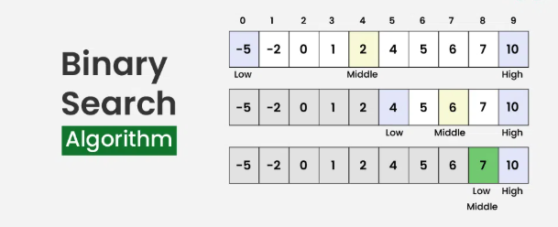
BINARY SEARCH ALGORITHM
Binary Search Algorithm is a searching algorithm used in a sorted array by repeatedly dividing the search interval in half.
The idea of binary search is to use the information that the array is sorted and reduce the time complexity to O(log N).

Slide 66
CONDITIONS TO APPLY BINARY SEARCH ALGORITHM IN A DATA STRUCTURE
The data structure must be sorted.
Access to any element of the data structure should take constant time

Slide 67
BINARY SEARCH ALGORITHM
Divide the search space into two halves by finding the middle index "mid".
Compare the middle element of the search space with the key.
If the key is found at middle element, the process is terminated.
If the key is not found at middle element, choose which half will be used as the next search space.
  If the key is smaller than the middle element, then the left side is used for next search.
  If the key is larger than the middle element, then the right side is used for next search.

Slide 68
BINARY SEARCH ALGORITHM
This process is continued until the key is found or the total search space is exhausted

Slide 69
HOW TO IMPLEMENT BINARY SEARCH ALGORITHM
The Binary Search Algorithm can be implemented in the following two ways
Iterative Binary Search Algorithm
Recursive Binary Search Algorithm

Slide 70
ITERATIVE BINARY SEARCH ALGORITHM
Here we use a while loop to continue the process of comparing the key and splitting the search space in two halves.

Slide 71
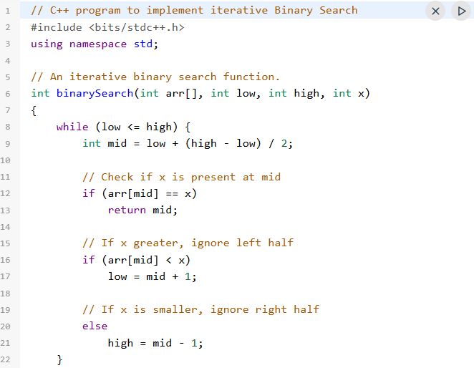
ITERATIVE BINARY SEARCH ALGORITHM

Slide 72
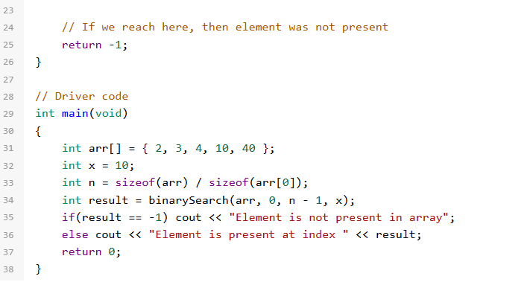
ITERATIVE BINARY SEARCH ALGORITHM

Slide 73
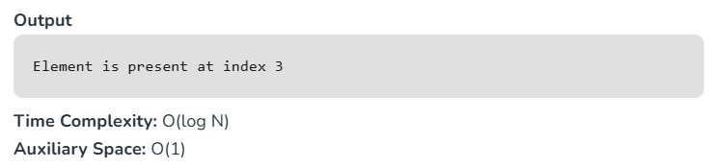
ITERATIVE BINARY SEARCH ALGORITHM

Slide 74
RECURSIVE BINARY SEARCH ALGORITHM
Create a recursive function and compare the mid of the search space with the key.
And based on the result either return the index where the key is found or call the recursive function for the next search space
Recursive binary search algorithm repeatedly divides the search interval in half. It's implemented recursively.

Slide 75
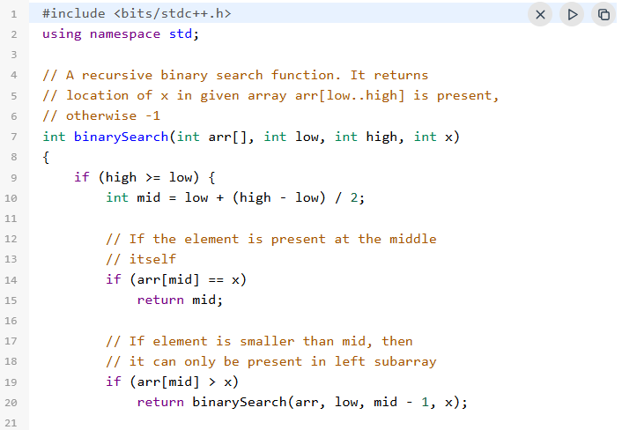
RECURSIVE BINARY SEARCH ALGORITHM

Slide 76
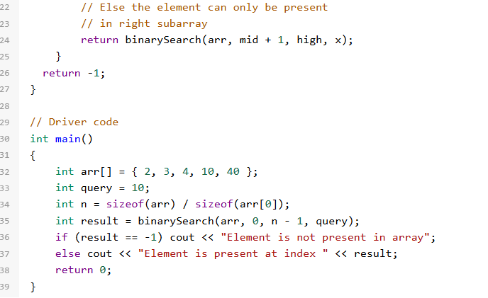
RECURSIVE BINARY SEARCH ALGORITHM

Slide 77
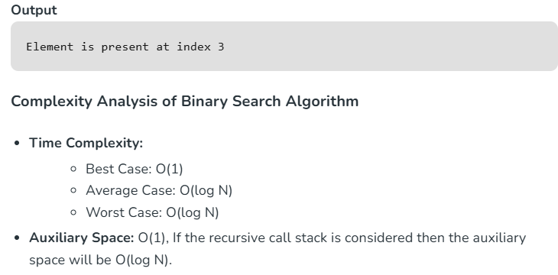
RECURSIVE BINARY SEARCH ALGORITHM

Slide 78
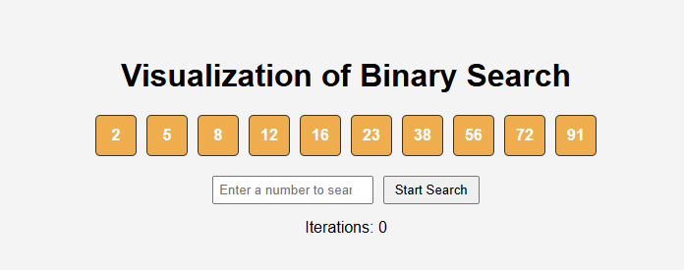
BINARY SEARCH VISUALIZER

Slide 79
APPLICATIONS OF BINARY SEARCH ALGORITHM
Binary search can be used as a building block for more complex algorithms used in machine learning, such as algorithms for training neural networks or finding the optimal hyperparameters for a model.
It can be used for searching in computer graphics such as algorithms for ray tracing or texture mapping.
It can be used for searching a database.

Slide 80
THE BRUTE FORCE STRING MATCHING ALGORITHM
The Brute Force string matching algorithm, also known as the naive algorithm, compares a pattern string with all possible substrings of a larger text string.
It works by sliding the pattern across the text, character by character, and checking for matches. If a mismatch is found, the pattern is shifted one position to the right in the text.
This process continues until a match is found or the pattern reaches the end of the text.

Slide 81
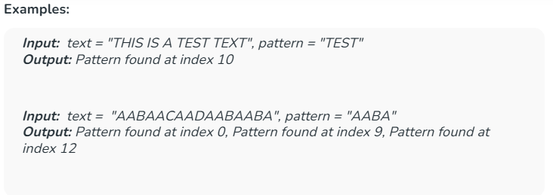
NAIVE ALGORITHM FOR PATTERN SEARCHING
Given text string with length n and a pattern with length m, the task is to prints all occurrences of pattern in text.
Note: You may assume that n > m.

Slide 82
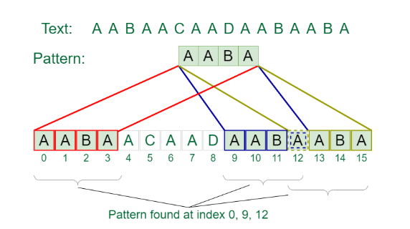
NAIVE ALGORITHM FOR PATTERN SEARCHING

Slide 83
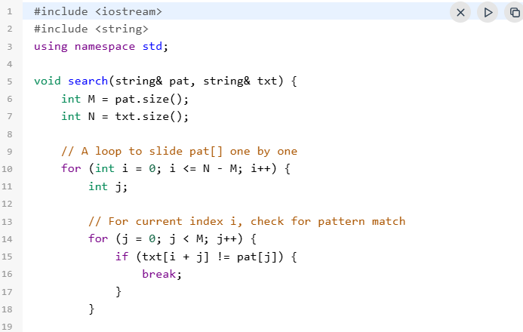
NAIVE PATTERN SEARCHING ALGORITHM
Slide the pattern over text one by one and check for a match. If a match is found, then slide by 1 again to check for subsequent matches.

Slide 84
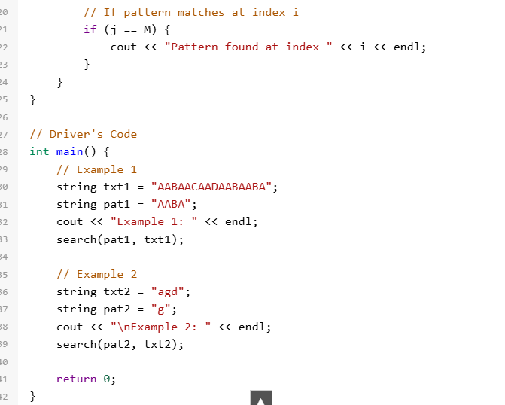
NAIVE PATTERN SEARCHING ALGORITHM

Slide 85
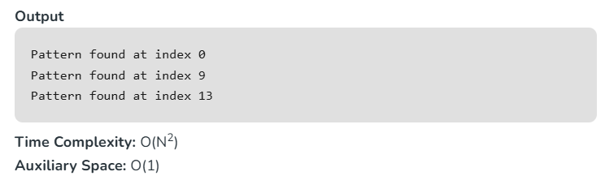
NAIVE PATTERN SEARCHING ALGORITHM

Slide 86
COMPLEXITY ANALYSIS OF NAIVE ALGORITHM FOR PATTERN SEARCHING
Best Case: O(n)
When the pattern is found at the very beginning of the text (or very early on).
The algorithm will perform a constant number of comparisons, typically on the order of O(n) comparisons, where n is the length of the pattern.

Slide 87
COMPLEXITY ANALYSIS OF NAIVE ALGORITHM FOR PATTERN SEARCHING
Worst Case: O(n2)
When the pattern doesn't appear in the text at all or appears only at the very end.
The algorithm will perform O((n-m+1)*m) comparisons, where n is the length of the text and m is the length of the pattern.
In the worst case, for each position in the text, the algorithm may need to compare the entire pattern against the text.

Slide 88
DIVIDE AND CONQUER ALGORITHM
Divide and Conquer Algorithm is a problem-solving technique used to solve problems by dividing the main problem into subproblems, solving them individually and then merging them to find solution to the original problem.
Divide and Conquer is mainly useful when we divide a problem into independent subproblems. If we have overlapping subproblems, then we use Dynamic Programming.

Slide 89
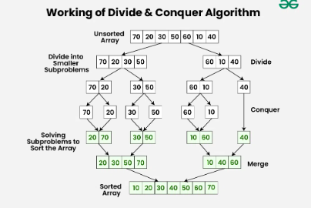
WORKING OF DIVIDE AND CONQUER ALGORITHM

Slide 90
WORKING OF DIVIDE AND CONQUER ALGORITHM
The above diagram shows working with the example of Merge Sort which is used for sorting.
Divide:
Break down the original problem into smaller subproblems.
Each subproblem should represent a part of the overall problem.
The goal is to divide the problem until no further division is possible.
In Merge Sort, we divide the input array in two halves. Please note that the divide step of Merge Sort is simple, but in Quick Sort, the divide step is critical. In Quick Sort, we partition the array around a pivot.

Slide 91
WORKING OF DIVIDE AND CONQUER ALGORITHM
Conquer:
Solve each of the smaller subproblems individually.
If a subproblem is small enough (often referred to as the “base case”), we solve it directly without further recursion.
The goal is to find solutions for these subproblems independently.
In Merge Sort, the conquer step is to sort the two halves individually.

Slide 92
WORKING OF DIVIDE AND CONQUER ALGORITHM
Merge:
Combine the sub-problems to get the final solution of the whole problem.
Once the smaller subproblems are solved, we recursively combine their solutions to get the solution of larger problem.
The goal is to formulate a solution for the original problem by merging the results from the subproblems.
In Merge Sort, the merge step is to merge two sorted halves to create one sorted array. Please note that the merge step of Merge Sort is critical, but in Quick Sort, the merge step does not do anything as both parts become sorted in place and the left part has all elements smaller (or equal( than the right part.

Slide 93
CHARACTERISTICS OF DIVIDE AND CONQUER ALGORITHM
Dividing the Problem: The first step is to break the problem into smaller, more manageable subproblems. This division can be done recursively until the subproblems become simple enough to solve directly.
Independence of Subproblems: Each subproblem should be independent of the others, meaning that solving one subproblem does not depend on the solution of another. This allows for parallel processing or concurrent execution of subproblems, which can lead to efficiency gains.

Slide 94
CHARACTERISTICS OF DIVIDE AND CONQUER ALGORITHM
Conquering Each Subproblem: Once divided, the subproblems are solved individually. This may involve applying the same divide and conquer approach recursively until the subproblems become simple enough to solve directly, or it may involve applying a different algorithm or technique.
Combining Solutions: After solving the subproblems, their solutions are combined to obtain the solution to the original problem. This combination step should be relatively efficient and straightforward, as the solutions to the subproblems should be designed to fit together seamlessly.

Slide 95
ADVANTAGES OF DIVIDE AND CONQUER ALGORITHM
Solving difficult problems: Divide and conquer technique is a tool for solving difficult problems conceptually. e.g. Tower of Hanoi puzzle. It requires a way of breaking the problem into sub-problems, and solving all of them as an individual cases and then combining sub- problems to the original problem.
Algorithm efficiency: The divide-and-conquer algorithm often helps in the discovery of efficient algorithms. It is the key to algorithms like Quick Sort and Merge Sort, and fast Fourier transforms.

Slide 96
ADVANTAGES OF DIVIDE AND CONQUER ALGORITHM
Parallelism: Normally Divide and Conquer algorithms are used in multi-processor machines having shared-memory systems where the communication of data between processors does not need to be planned in advance, because distinct sub-problems can be executed on different processors.
Memory access: These algorithms naturally make an efficient use of memory caches. Since the subproblems are small enough to be solved in cache without using the main memory that is slower one. Any algorithm that uses cache efficiently is called cache oblivious.

Slide 97
DISADVANTAGES OF DIVIDE AND CONQUER ALGORITHM
Overhead: The process of dividing the problem into subproblems and then combining the solutions can require additional time and resources. This overhead can be significant for problems that are already relatively small or that have a simple solution.
Complexity: Dividing a problem into smaller subproblems can increase the complexity of the overall solution. This is particularly true when the subproblems are interdependent and must be solved in a specific order.

Slide 98
DISADVANTAGES OF DIVIDE AND CONQUER ALGORITHM
Difficulty of implementation: Some problems are difficult to divide into smaller subproblems or require a complex algorithm to do so. In these cases, it can be challenging to implement a divide and conquer solution.
Memory limitations: When working with large data sets, the memory requirements for storing the intermediate results of the subproblems can become a limiting factor.

Slide 99
TREE TRAVERSAL
Traversal is a process to visit all the nodes of a tree and may print their values too. Because, all nodes are connected via edges (links) we always start from the root (head) node.
That is, we cannot randomly access a node in a tree.

Slide 100
TREE TRAVERSAL
There are three ways which we use to traverse a tree −
  In-order Traversal
  Pre-order Traversal
  Post-order Traversal

Slide 101
IN-ORDER TRAVERSAL
In this traversal method, the left subtree is visited first, then the root and later the right sub-tree.
We should always remember that every node may represent a subtree itself.
If a binary tree is traversed in-order, the output will produce sorted key values in an ascending order.

Slide 102
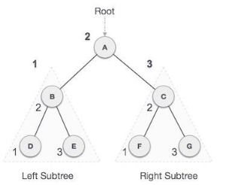
IN-ORDER TRAVERSAL

Slide 103
IN-ORDER TRAVERSAL
We start from A, and following in-order traversal, we move to its left subtree B.B is also traversed in-order. The process goes on until all the nodes are visited. The output of in-order traversal of this tree will be −
D B E A F C G

Slide 104
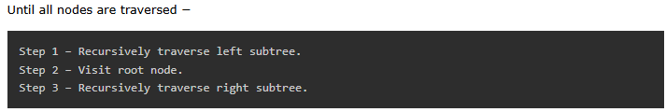
ALGORITHM

Slide 105
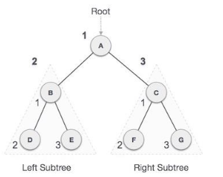
PRE-ORDER TRAVERSAL
In this traversal method, the root node is visited first, then the left subtree and finally the right subtree.

Slide 106
PRE-ORDER TRAVERSAL
We start from A, and following pre-order traversal, we first visit A itself and then move to its left subtree B. B is also traversed pre-order. The process goes on until all the nodes are visited. The output of pre-order traversal of this tree will be −
A → B → D → E → C → F → G
ABDECFG

Slide 107
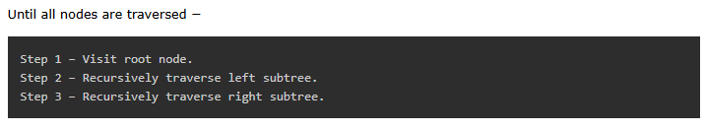
ALGORITHM

Slide 108
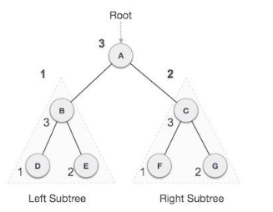
POST-ORDER TRAVERSAL
In this traversal method, the root node is visited last, hence the name. First we traverse the left subtree, then the right subtree and finally the root node.

Slide 109
POST-ORDER TRAVERSAL
We start from A, and following pre-order traversal, we first visit the left subtree B. B is also traversed post-order. The process goes on until all the nodes are visited. The output of post-order traversal of this tree will be
D → E → B → F → G → C → A

Slide 110
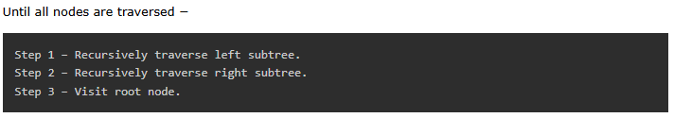
ALGORITHM

Slide 111
Structure of Heap and Merge Sort

Slide 112
DECREASE AND CONQUER
Decrease and conquer is a technique used to solve problems by reducing the size of the input data at each step of the solution process.
This technique is similar to divide-and-conquer, in that it breaks down a problem into smaller subproblems, but the difference is that in decrease-and-conquer, the size of the input data is reduced at each step.

Slide 113
DECREASE AND CONQUER
The technique is used when it's easier to solve a smaller version of the problem, and the solution to the smaller problem can be used to find the solution to the original problem.
  Some examples of problems that can be solved using the decrease-and-conquer technique include binary search, finding the maximum or minimum element in an array, and finding the closest pair of points in a set of points.
  The main advantage of decrease-and-conquer is that it often leads to efficient algorithms, as the size of the input data is reduced at each step, reducing the time and space complexity of the solution. However, it's important to choose the right strategy for reducing the size of the input data, as a poor choice can lead to an inefficient algorithm.

Slide 114
IMPLEMENTATIONS OF DECREASE AND CONQUER
This approach can be either implemented as top-down or bottom-up.
  Top-down approach : It always leads to the recursive implementation of the problem.
  Bottom-up approach : It is usually implemented in iterative way, starting with a solution to the smallest instance of the problem.

Slide 115
VARIATIONS OF DECREASE AND CONQUER
There are three major variations of decrease-and-conquer:
Decrease by a constant
Decrease by a constant factor
Variable size decrease

Slide 116
VARIATIONS OF DECREASE AND CONQUER
There are three major variations of decrease-and-conquer:
Decrease by a constant
Decrease by a constant factor
Variable size decrease

Slide 117
VARIATIONS OF DECREASE AND CONQUER
Decrease by a Constant : In this variation, the size of an instance is reduced by the same constant on each iteration of the algorithm.
Typically, this constant is equal to one , although other constant size reductions do happen occasionally.
Below are example problems :
  Insertion sort
  Graph search algorithms: DFS, BFS
  Topological sorting
  Algorithms for generating permutations, subsets

Slide 118
VARIATIONS OF DECREASE AND CONQUER
Decrease by a Constant factor: This technique suggests reducing a problem instance by the same constant factor on each iteration of the algorithm.
In most applications, this constant factor is equal to two. A reduction by a factor other than two is especially rare. Decrease by a constant factor algorithms are very efficient especially when the factor is greater than 2 as in the fake-coin problem.
Below are example problems :
  Binary search
  Fake-coin problems
  Russian peasant multiplication

Slide 119
VARIATIONS OF DECREASE AND CONQUER
Variable-Size-Decrease : In this variation, the size-reduction pattern varies from one iteration of an algorithm to another. As, in problem of finding gcd of two number though the value of the second argument is always smaller on the right-handside than on the left-hand side, it decreases neither by a constant nor by a constant factor.
Below are example problems :
  Computing median and selection problem.
  Interpolation Search
  Euclid’s algorithm

Slide 120
VARIATIONS OF DECREASE AND CONQUER
There may be a case that problem can be solved by decrease-by-constant as well as decrease-by-factor variations, but the implementations can be either recursive or iterative.
The iterative implementations may require more coding effort, however they avoid the overload that accompanies recursion.

Slide 121
ADVANTAGES OF DECREASE AND CONQUER
Simplicity: Decrease-and-conquer is often simpler to implement compared to other techniques like dynamic programming or divide-and-conquer.
Efficient Algorithms: The technique often leads to efficient algorithms as the size of the input data is reduced at each step, reducing the time and space complexity of the solution.
Problem-Specific: The technique is well-suited for specific problems where it's easier to solve a smaller version of the problem

Slide 122
DISADVANTAGES OF DECREASE AND CONQUER
Problem-Specific: The technique is not applicable to all problems and may not be suitable for more complex problems.
Implementation Complexity: The technique can be more complex to implement when compared to other techniques like divide-and-conquer, and may require more careful planning.

Slide 123
DEPTH FIRST SEARCH (DFS) ALGORITHM
Depth First Search (DFS) algorithm is a recursive algorithm for searching all the vertices of a graph or tree data structure.
This algorithm traverses a graph in a depthward motion and uses a stack to remember to get the next vertex to start a search, when a dead end occurs in any iteration

Slide 124

DEPTH FIRST SEARCH (DFS) ALGORITHM

Slide 125

DEPTH FIRST SEARCH (DFS) ALGORITHM
As in the example given above, DFS algorithm traverses from S to A to D to G to E to B first, then to F and lastly to C.
It employs the following rules.

Slide 126

DEPTH FIRST SEARCH (DFS) ALGORITHM

Slide 127

DEPTH FIRST SEARCH (DFS) ALGORITHM

Slide 128

DEPTH FIRST SEARCH (DFS) ALGORITHM

Slide 129
COMPLEXITY OF DFS ALGORITHM
Time Complexity:
    The time complexity of the DFS algorithm is represented in the form of O(V + E), where V is the number of nodes and E is the number of edges.
Space Complexity:
The space complexity of the DFS algorithm is O(V)

Slide 130
BREADTH FIRST SEARCH (BFS) ALGORITHM
Breadth First Search (BFS) algorithm traverses a graph in a breadthward motion to search a graph data structure for a node that meets a set of criteria.
It uses a queue to remember the next vertex to start a search, when a dead end occurs in any iteration.
Breadth First Search (BFS) algorithm starts at the tree root and explores all nodes at the present depth prior to moving on to the nodes at the next depth level.

Slide 131

BREADTH FIRST SEARCH (BFS) ALGORITHM

Slide 132

BREADTH FIRST SEARCH (BFS) ALGORITHM
As in the example given above, BFS algorithm traverses from A to B to E to F first then to C and G lastly to D.
It employs the following rules.

Slide 133

BREADTH FIRST SEARCH (BFS) ALGORITHM

Slide 134

BREADTH FIRST SEARCH (BFS) ALGORITHM

Slide 135

BREADTH FIRST SEARCH (BFS) ALGORITHM

Slide 136
COMPLEXITY OF BFS ALGORITHM
Time Complexity
The time complexity of the BFS algorithm is represented in the form of O(V + E), where V is the number of nodes and E is the number of edges.
Space Complexity
The space complexity of the BFS algorithm is O(V).

Slide 137
Code for Prim Algorithm:

